Slide 1
Random Forest Classifier

Slide 2
Random Forest
Popular supervised machine learning algorithm
It is used for both classification and regression problems
Based on the concept of ensemble learning, which enables users to combine multiple classifiers to solve a complex problem and to also improve the performance of the model
The random forest algorithm relies on multiple decision trees and accepts the results of the predictions from each tree
Based on the majority votes of predictions, it determines the result

Slide 3
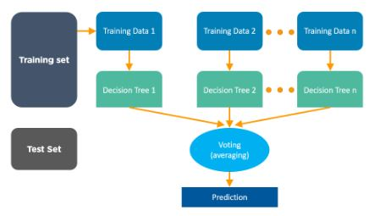
Random Forest Algorithm

Slide 4
Random Forest Algorithm Features
Provides higher accuracy than other algorithms
Gives estimates of what variables are important in the classification
Handles missing data efficiently, and the generated forests can be saved for future use with other data
Computes proximities between pairs of cases that can be used in clustering, locating outliers, or to give interesting views of the data

Slide 5
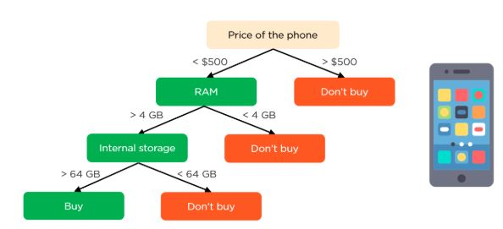
In this decision tree, the parent/root node and the internal nodes represent the phone’s features, while the leaf nodes are the outputs.
The edges represent the connections between the nodes based on the values from the features.
Based on the price, RAM, and internal storage, consumers can decide whether they want to purchase the phone.
The problem with this decision tree is that you only have limited information, which may not always provide accurate results.

Slide 6
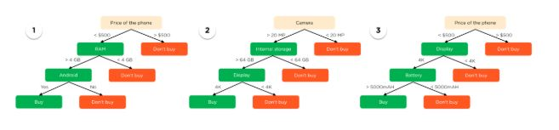
We have created three different decision trees to build a random forest model.
Using a random forest model will improve your results, as it provides diversity into building the model with several different features.

Slide 7
Assumptions For The Random Forest Algorithm
There should be some actual values in the feature variables of the dataset, which will give the classifier a better chance to predict accurate results, rather than provide an estimation. Missing values should be handled from training the model.
The predictions from each tree must have very low correlations.

Slide 8
Steps To Build A Random Forest
Randomly select “K” features from total “m” features where k < m
Among the “K” features, calculate the node “d” using the best split point
Split the node into daughter nodes using the best split method
Repeat the previous steps until you reach the “l” number of nodes
Build a forest by repeating all steps for “n” number times to create “n” number of trees
After the random forest trees and classifiers are created, predictions can be made using the following steps:
Run the test data through the rules of each decision tree to predict the outcome and then store that predicted target outcome
Calculate the votes for each of the predicted targets
The most highly voted predicted target is the final prediction

Slide 9
Random Forest Applications
In the field of banking, it is used to predict fraudulent customers
Random forests are used to analyze the symptoms of patients and diagnose diseases
In the ecommerce field, recommendation lists help predict purchases based on customer activity
Analyze stock market trends to predict profit or loss using the random forest algorithm

